Slide 1
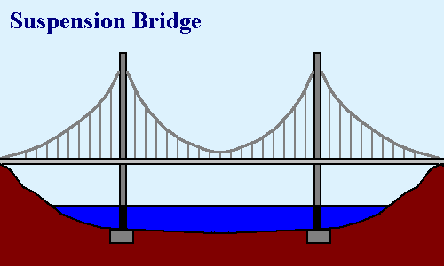
Cultural संस्कृतिक
CULTURAL LATITUDE/FREEDOM
सांस्कृतिक अक्षांश/स्वतंत्रता
BIBLICAL PRINCIPLES
बाइबिल सिद्धांत
BIBLICAL CONSTANTS
(Acts 2:42,46-47)
बाइबिल स्थिरांक
(प्रेरित 2:42,46-47)
Biblical बाइबल संबंधी
Notes:
Biblical parameters, framework-- flexibility
Each congregation & leadership– how to obey the biblical constants and apply the biblical principles in their own unique context
When I come in as an itinerant teacher: no right
Some of you earn the right to address also the top issues by living long-term in the culture—but still the biblical framework, foundation must remain the same
Change: all occurs on top—biblical doesn’t change

