Slide 1

礼拝の聖書的原則
Ron Man
Worship Resources Intl.
worship-resources.org
letusdrawnear.org
Notes:
1
How do we balance the need for biblical fidelity with the need for cultural sensitivity and relevance in our worship? Of course you face that issue no matter where in the world you are, no matter what culture you are ministering in. It is an ongoing challenge– but of course not a new one. The early church faced its own set of cultural and cross-cultural challenges in this area, as Jews and Greeks and Romans were included in one body in Christ.
And with all the debates about worship forms, styles and practices which continue to rage today, the church of Jesus Christ desperately needs a unifying understanding of the unchanging, non-negotiable foundations of worship—and we must turn to the Scriptures for this purpose. We need a sense of what MUST NOT change, as well as some guidance in what MAY change– and above all we need the wisdom and discernment to tell the difference.
Yet even with this commitment to the Scriptures as our guide for worship, we immediately run into a problem when we go to the New Testament for models and guidelines for congregational worship. That problem has been summarized by John Piper as the “stunning indifference” of the New Testament writers to issues of form and practice of corporate worship. We search the pages of the New Testament in vain for much in the way of specifics, much less structures or liturgies. Even in the epistles, where we might reasonably expect Paul and the other writers to address these issues as they write to guide and encourage brand new churches, we find frustratingly little.
It is a reasonable assumption that the virtual silence of the New Testament writers on the matters of form and style for worship means that the Lord intends for us to have considerable latitude and flexibility in these areas. But that does not mean TOTAL freedom– does not mean that just anything is appropriate or allowed. How do we discern the balance? How do we bridge the historical and practical gap between the Scriptural mandates and our cultural context? How can our worship be “in” the world but not “of” the world? Where do worship and culture intersect?
I would like to suggest a model which at the same time gives biblical guidance yet allows for true Biblical freedom.

Slide 2
礼拝と文化
Notes:
2
How do we balance the need for biblical fidelity with the need for cultural sensitivity and relevance in our worship? Of course you face that issue no matter where in the world you are, no matter what culture you are ministering in. It is an ongoing challenge– but of course not a new one. The early church faced its own set of cultural and cross-cultural challenges in this area, as Jews and Greeks and Romans were included in one body in Christ.
And with all the debates about worship forms, styles and practices which continue to rage today, the church of Jesus Christ desperately needs a unifying understanding of the unchanging, non-negotiable foundations of worship—and we must turn to the Scriptures for this purpose. We need a sense of what MUST NOT change, as well as some guidance in what MAY change– and above all we need the wisdom and discernment to tell the difference.
Yet even with this commitment to the Scriptures as our guide for worship, we immediately run into a problem when we go to the New Testament for models and guidelines for congregational worship. That problem has been summarized by John Piper as the “stunning indifference” of the New Testament writers to issues of form and practice of corporate worship. We search the pages of the New Testament in vain for much in the way of specifics, much less structures or liturgies. Even in the epistles, where we might reasonably expect Paul and the other writers to address these issues as they write to guide and encourage brand new churches, we find frustratingly little.
It is a reasonable assumption that the virtual silence of the New Testament writers on the matters of form and style for worship means that the Lord intends for us to have considerable latitude and flexibility in these areas. But that does not mean TOTAL freedom– does not mean that just anything is appropriate or allowed. How do we discern the balance? How do we bridge the historical and practical gap between the Scriptural mandates and our cultural context? How can our worship be “in” the world but not “of” the world? Where do worship and culture intersect?
I would like to suggest a model which at the same time gives biblical guidance yet allows for true Biblical freedom.

Slide 3
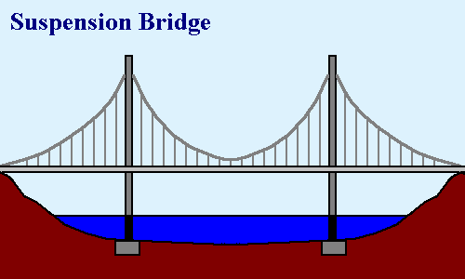
Notes:
3
Suspension bridge

Slide 4
文化
形式の自由
聖書にある原則
聖書にある不変のもの
(使徒2:42,46-47)
聖書
Notes:
4
Biblical parameters, framework-- flexibility
Each congregation & leadership– how to obey the biblical constants and apply the biblical principles in their own unique context
When I come in as an itinerant teacher: no right
Some of you earn the right to address also the top issues by living long-term in the culture—but still the biblical framework, foundation must remain the same
Change: all occurs on top—biblical doesn’t change

Slide 5
聖書にある不変のもの (使徒 2:42,46-47)
彼らは使徒たちの教えを堅く守り、交わりをし、パンを裂き、祈りをしていた。・・・そして毎日、心を一つにして宮に集まり、家でパンを裂き、喜びと真心をもって食事をともにし、神を賛美し、すべての民に好意を持たれた。主も毎日救われる人々を仲間に加えてくださった。
Notes:
5

Slide 6
聖書にある不変のもの (使徒 2:42,46-47)
使徒の教え
交わり
パンを裂く
祈り
神を賛美
Notes:
6

Slide 7
聖書にある
不変のもの
（使徒2:42,46-47)
Notes:
7

Slide 8
聖書にある不変のもの (使徒 2:42,46-47)
神の御言葉
交わり
主の聖餐
祈り
賛美
Notes:
8

Slide 9
文化
形式の自由
聖書にある
不変のもの
(使徒 2:42,46-47)
聖書
Notes:
9
Biblical parameters, framework-- flexibility
Each congregation & leadership– how to obey the biblical constants and apply the biblical principles in their own unique context
When I come in as an itinerant teacher: no right
Some of you earn the right to address also the top issues by living long-term in the culture—but still the biblical framework, foundation must remain the same
Change: all occurs on top—biblical doesn’t change

Slide 10
旧約聖書
“来て、見なさい”
Notes:
10
God extended an invtiation to all peoples, but to come to HIM they had to come THROUGH Israel, had to become a Jew. He centralized His presence and working among His chosen people.

Slide 11
新約聖書
“出て行って伝えなさい！”
Notes:
11
In the New Testament we see a totally different pattern. Christianity is "go and tell" faith, a missionary faith. We're to go to every people and tribe and tongue and nation with the message of the gospel. The church is not a national entity, but a spiritual nation spread throughout all the earth. That means that worship needs to fit in with many different cultures and traditions. This is perhaps one of the main reasons why the NT gives no guidelines as to the exact FORM of worship: so that it can be adjusted to many diffente cultures.
But still has to look like something!

Slide 12
形式の自由
多様性がありながらも一致
教会・教派の歴史と伝統
“伝統は素晴らしいしもべであるが、同時に、ひどい主人である。”
文化的背景
“人々の心に届く言語”
Notes:
12
Guides:
1. Ch/denom history and trads.– tradition is not an enemy!! UNLESS it's put on the same level of authority and unchangeability as Scripture "tradition…."
2. Culture: take into account the heart language of the people (no Bach fugues in African village), though with DISCERNMENT– some cultural aspects may not be appropriate to use for the worship of God because of their associations; culture shouldn't control, but shouldn't be ignored either

Slide 13
形式の自由
これこそが正しい唯一の方法というものはない
聖書にある不変のもの（原則）によって定められる制限
神様の好みは私達の好みよりもはるかに幅広い！
Notes:
13

Slide 14
礼拝と文化のナイロビ宣言
(www.worship.ca/docs)
「クリスチャンの礼拝は、少なくとも４つの方法で私達の文化とダイナミックに関わる」
第一に、それは、一文化を越えて、あらゆる所にいるあらゆる人々に当てはまるものである。
第二に、それは、文脈化されたもので、 （性質と文化において）各地域の文化に適応されるものである。Second, it is
第三に、それは、その地の文化によって聖書的基準を妥協しないものである。
第四に、それは、文化間を行き来するもので、様々な文化によって共有されるべきものである。
Notes:
14
Transcultural: biblical constants and principles we’ve looked at
Contextual: contextualization; heart language
Counter-cultural: not buy into everything- informed by a secular, worldly, materialistic, even immoral mindset– or a religious one which runs counter to Chrty. or the gospel; Scripture must guide and control; as you know: use wisdom and discernment; ASSOCIATIONS in culture (many of you could give examples)
Cross-cultural: the positive side of globalization—draw from riches of other cultures’ worship expressions (globalization: influence of Western popular music—like it or not, part of young people’s culture everywhere, can’t ignore; but other influences too)

Slide 15
“礼拝の聖書的原則”
www.worr.org
リソース
Notes:
15
One suggested set of principles (listed on back of half-sheet on free table)
On website: application in a particular local church setting (Germany); “therefore, we will…”

Slide 16
God’s glory, and our joyful celebration of it in worship, should be the focus and goal of all life and ministry.
Whether, then, you eat or drink or whatever you do, do all to the glory of God.
(1 Cor 10:31)
Worship is an end it itself. By definition other types of ministry necessarily have horizontal, man-focused aspects; but worship is purely vertically focused. It is the primary purpose for which God created us and therefore our highest endeavor and greatest fulfillment. (Isaiah 43:6-7; Psalm 16:11; Matthew 22:35-38; 1 Peter 4:11)
THEREFORE: We shall give worship careful focus and attention in the life of this church. We will relate all of our activities to it and to the goal of magnifying the glory of God. We will make explicit God’s glory as our most important pursuit, aim and preoccupation.
神様の栄光と、私達が礼拝を通してその神様の栄光を喜び祝うことが私達の人生と働きのすべての中心であるべきである。
「こういうわけで、あなたがたは、食べるにも、飲むにも、何をするにも、ただ神の栄光を現すためにしなさい。」１コリント10:31
礼拝はそれ自体が目的である。他の働きは、必ず、横の関係である人に焦点を当てる一面がある。けれども、礼拝は、純粋に、縦の関係に焦点を合わせるものである。それこそが、神様が私達を創造した目的である故に、私達がし得る最高の試みであり、達成しうる最大の成果ということができる。 (イザヤ43:6-7; 詩篇16:11; マタイ22:35-38; 1 ペテロ4:11)
故に：私達は、教会生活の中で、礼拝に注意深く焦点を当てましょう。私達のすべての活動を礼拝と、神様の栄光をたたえることに照らし合わせるのです。私達は、神様の栄光を表すことを何よりも求め、目指し、それに没頭するべきなのです。
Notes:
16

Slide 17
神をたたえる礼拝
1. 神様の栄光と、私達が礼拝を通してその神様の栄光を喜び祝うことが私達の人生と働きのすべての中心であるべきである。
「こういうわけで、あなたがたは、食べるにも、飲むにも、何をするにも、ただ神の栄光を現すためにしなさい。」
(1コリント 10:31)
Notes:
17

Slide 18
神様中心の礼拝
2. 礼拝はまず第一に、そして、何よりも、神様のためのものである。
「ただ神様だけを礼拝しなさい。」
(黙示録19:10; 22:9)
「クリスチャンが行う様々な行為の中で、礼拝だけが、それ自体が目的のものである。」 (ジョン・パイパー)
「消費者中心の礼拝は、その消費者と言うのが、神様を指しているならば問題ではないと思います。」 (エリック・アレクサンダー)
Notes:
18
Eric Alexander: “I don’t have any trouble with consumer-oriented worship, as long as we remember who the Consumer is.”

Slide 19
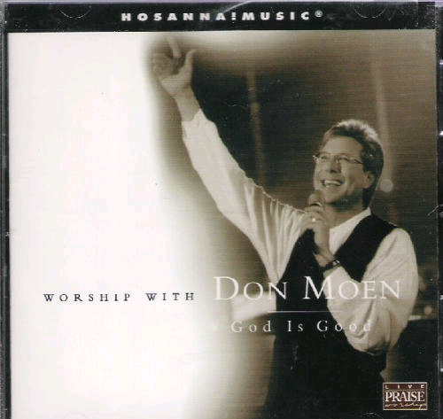
Notes:
19

Slide 20
対話である礼拝
3. 礼拝は、神様とその民との間の対話であり、 啓示と応答のリズムでなされる。
「まことに主は大いなる方、大いに賛美されるべき方。」(詩篇96:4)
Notes:
20

Slide 21
「神様を礼拝するには神様を知る必要がある。」
(エリック・アレクサンダー)
Notes:
21
God reveals His glory, worship is our response
Order is important: God always initiates
Rom. 11:33-36 eleven chapters of doctrine, then Paul bursts out in praise: „Oh, the depth of the riches ¹both of the wisdom and knowledge of God!”
Worship services to be a dialogue betw, God and man, a dialogue of revel. & response
This is why the Scriptures are so important; Stott and others remind us how we need much more Scr. In our services– been in many churches where first first of Scr. Is when preacher gets up– means 30 mintues of response w/o anything to respond to!!

Slide 22
「神学の目的は、賛美である。私達は神をほめたたえるために学ぶのである。」
(J. I. パッカー)
Notes:
22
God reveals His glory, worship is our response
Order is important: God always initiates
Rom. 11:33-36 eleven chapters of doctrine, then Paul bursts out in praise: „Oh, the depth of the riches ¹both of the wisdom and knowledge of God!”
Worship services to be a dialogue betw, God and man, a dialogue of revel. & response
This is why the Scriptures are so important; Stott and others remind us how we need much more Scr. In our services– been in many churches where first first of Scr. Is when preacher gets up– means 30 mintues of response w/o anything to respond to!!

Slide 23
御言葉に満ち溢れた礼拝
4. 私達の礼拝の中心は御言葉であるべき。
「そのすぐれた偉大さのゆえに、神をほめたたえよ。」(詩篇150:2)
Notes:
23
Biblical pattern of Rev. and Resp.: worship is a DIALOGUE
We need to let God speak to us through His Word; then we respond with our worship
Not just talk about, sing about God– but hear from His own Word what He says about Himself– and then respond with our hearts and voices

Slide 24
会衆が参加する礼拝
5. 礼拝は、神の民すべてに課されている責任である。
「そうすれば、あなたの民、あなたの牧場の羊である私達は、とこしえまでも、あなたに感謝し、代々限りなくあなたの誉れを語り告げましょう。」
(詩篇 79:13)
Notes:
24

Slide 25
礼拝は動詞である(ロバート・ウェバー)
問うべきことは、「人前で歌えるような賜物がありますか？」ではなく、「主に向かって歌う歌はありますか？」であるべき。
Notes:
25

Slide 26
音は大き過ぎず
音階は高過ぎず
難し過ぎず
新し過ぎず
Notes:
26

Slide 27
キリストによって導かれる礼拝
6. 私達の礼拝は、私達の大祭司であるキリストにより、またキリストにあって受け入れられるものとなる。
会衆の中で、わたしはあなたを賛美しよう。
(ヘブル2:12)
Notes:
27
Not the excellence of what we do; not because we have found the right from or style; not because we're so committed or worthy– but because of Christ's excellence and worthiness. We need to be conscious of our total acceptance and acces to the Father because we come in Christ– no fear, no doubt– blessed assurance.

Slide 28
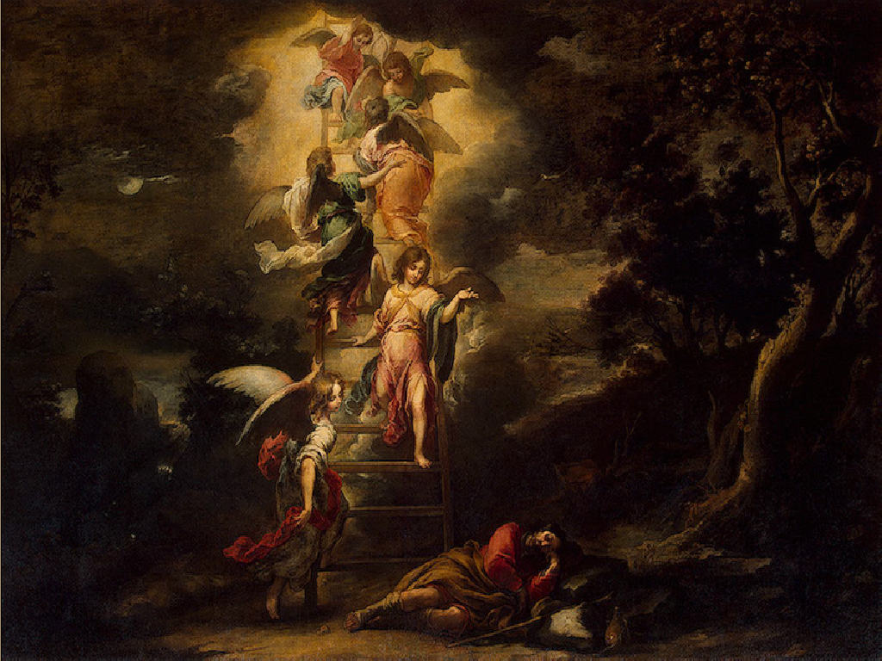
Notes:
28

Slide 29
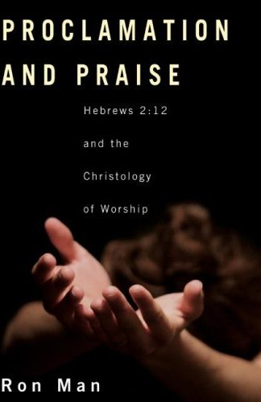
宣言と賛美
ヘブル2：12と礼拝のキリスト学
ロン・マン
Notes:
29

Slide 30
キリストによって導かれる礼拝
アルバムのカバーのあったコメント:
「演奏者は、その晩ずっと、賛美のメロディーで持って人々を神様の臨在へと導いた。」
間違ってます！
Notes:
30
Not the excellence of what we do; not because we have found the right from or style; not because we're so committed or worthy– but because of Christ's excellence and worthiness. We need to be conscious of our total acceptance and acces to the Father because we come in Christ– no fear, no doubt– blessed assurance.

Slide 31
聖霊の助けによって可能となる礼拝
7. 私達の礼拝は、聖霊の助けによって成り立ち、動機を与えられて、力を与えられる。
「神の御霊によって礼拝をし、キリスト・イエスを誇り、人間的なものを頼みにしない私達のほうこそ、割礼の者なのです。」(ﾋﾟﾘﾋﾟ3:3)
Notes:
31
Not the excellence of what we do; not because we have found the right from or style; not because we're so committed or worthy– but because of Christ's excellence and worthiness. We need to be conscious of our total acceptance and acces to the Father because we come in Christ– no fear, no doubt– blessed assurance.

Slide 32
人生全体を通しての礼拝
8. 礼拝は神様に対する、私達の人生全体を通しての応答である。
あなたがたのからだを、神に受け入れられる、聖い、生きた供え物としてささげなさい。それこそ、あなたがたの霊的な礼拝です。」(ローマ12:1)
Notes:
32

Slide 33
心からの礼拝
9.神様は、私達がどのような形で礼拝をするかよりも、
私達の心の状態に関心を持っておられる。
「わたしはいけにえよりも誠実を喜ぶ。」
(ホセア 6:6)
Notes:
33
Freedom of form
Cultivate a lifestyle of worship from the heart

Slide 34
“人はうわべを見るが、主は心を見る。”
(1 サムエル16:7)
Notes:
34
Freedom of form
Cultivate a lifestyle of worship from the heart

Slide 35
キリストのからだを建て上げる礼拝
10.礼拝を通して、キリストのからだがさらに一致し、建て上げられるべき。
「何事でも自己中心や虚栄からすることなく、へりくだって、互いに人を自分よりもすぐれた者と思いなさい。」（ﾋﾟﾘﾋﾟ2:3)
「そういうわけですから、私達は、平和に役立つことと
お互いの霊的成長に役立つことを追い求めましょう。」 (ローマ14:19)
Notes:
35
Importance of Community: in the church, we worship together-"O magnify the Lord with me, and let us exalt His name TOGETHER:"
Not a gathering for everyone to worship individually (face forward)
More important than the idolatry of our presonal preferences
Not a natural grouping of people; not an affinity group, not a club of people who are drawn together
Unity is elusive, must be worked at, HS must produce

Slide 36
あなたは、他の人が準備した歌を歌うのを拒否するほどその人に対する愛がないのですか？もしそうだとしたら、私達には、礼拝でどんな音楽を用いるかよりも、もっと大きな問題があることになります。
(スティーブ・バイアリー)
Notes:
36

Slide 37
世代を越えた礼拝
11. キリストの体では、若い人も、老いた人も互いを必要とする。
「 若い男よ、若い女よ。年老いた者と幼い者よ。彼らに主の名をほめたたえさせよ。主の御名だけがあがめられ、その威光は地と天の上にあるからだ。」
(詩篇 148:12-13)
「老人達、・・・年をとった婦人達、・・・若い婦人達・・・若い人々・・・」（テトス2:2-8)
Notes:
37
Young people need to honor and learn from those who have been walking with the Lord for 20, 30, 40 years or more: But older people also need the freshness and vitality which younger belivers can bring to the body. Doens't cut it to have each group run off to its own corner to do worship ist own way. Need tolearn from each other (BOTH ways); need to enage in the hard work of trying to tolerate and understand the faith expressions of others within the body.
The Psalmist almost certainly was not saying, "Alright, young men and maidens down in the gym, older people in the fellowship hall."

Slide 38
教えられていく礼拝
12. これらの事は何度も教え伝えられていかなければならない。
「終わりに、兄弟たちよ。主イエスにあって、お願いし、また勧告します。あなたがたはどのように歩んで神を喜ばすべきかを私達から学んだように、また、事実いまあなたがたが歩んでいるように、ますますそのように歩んでください。」
(1 テサロニケ 4:1)
Notes:
38
We must continually teach these principles, pointing people constantly to God and explaining the "why" and not just the "what" of what we are doing.

Slide 39
形式の柔軟性
聖書にある原則
聖書にある
不変のもの
(使徒 2:42,46-47)
Notes:
39

Slide 40
どうか、忍耐と励ましの神が、あなたがたを、キリスト・イエスにふさわしく、互いに同じ思いを持つようにしてくださいますように。それは、あなたがたが、心を一つにし、声を合わせて、私達の主イエス・キリストの父なる神を
ほめたたえるためです。
(ローマ 15:5-6)
Notes:
40

Slide 41
礼拝の聖書的原則
Notes:
41
How do we balance the need for biblical fidelity with the need for cultural sensitivity and relevance in our worship? Of course you face that issue no matter where in the world you are, no matter what culture you are ministering in. It is an ongoing challenge– but of course not a new one. The early church faced its own set of cultural and cross-cultural challenges in this area, as Jews and Greeks and Romans were included in one body in Christ.
And with all the debates about worship forms, styles and practices which continue to rage today, the church of Jesus Christ desperately needs a unifying understanding of the unchanging, non-negotiable foundations of worship—and we must turn to the Scriptures for this purpose. We need a sense of what MUST NOT change, as well as some guidance in what MAY change– and above all we need the wisdom and discernment to tell the difference.
Yet even with this commitment to the Scriptures as our guide for worship, we immediately run into a problem when we go to the New Testament for models and guidelines for congregational worship. That problem has been summarized by John Piper as the “stunning indifference” of the New Testament writers to issues of form and practice of corporate worship. We search the pages of the New Testament in vain for much in the way of specifics, much less structures or liturgies. Even in the epistles, where we might reasonably expect Paul and the other writers to address these issues as they write to guide and encourage brand new churches, we find frustratingly little.
It is a reasonable assumption that the virtual silence of the New Testament writers on the matters of form and style for worship means that the Lord intends for us to have considerable latitude and flexibility in these areas. But that does not mean TOTAL freedom– does not mean that just anything is appropriate or allowed. How do we discern the balance? How do we bridge the historical and practical gap between the Scriptural mandates and our cultural context? How can our worship be “in” the world but not “of” the world? Where do worship and culture intersect?
I would like to suggest a model which at the same time gives biblical guidance yet allows for true Biblical freedom.

